Slide 1
QuizLet
Jarrett

Slide 2
Quizlet the World’s Largest Student and teachers online Learning community!
Mission: To help students and their teachers practice and master whatever they are learning. Quizlet provides engaging, customizable activities with contributions from people everywhere (Quizlet.com).
20 Million monthly learners!
2+ Billion study sessions!!
150 Million Study Sets!!!

Slide 3
Study Sets
Are tools to help students study on any subject or content area.
Tools: flashcards, games, practice test, and learning and spelling tools.

Slide 4
Quizlet Live is a in class team game where students will work together to answer the questions. In the game the student will be matching different terms and definitions from the study set that the teachers has chosen for the game.
What you need for the game:
A Quizlet study set (at least 12 terms)
At least 6 students
A computer, tablet, or phone for each student playing.
10-20 minutes of class time.

Slide 5
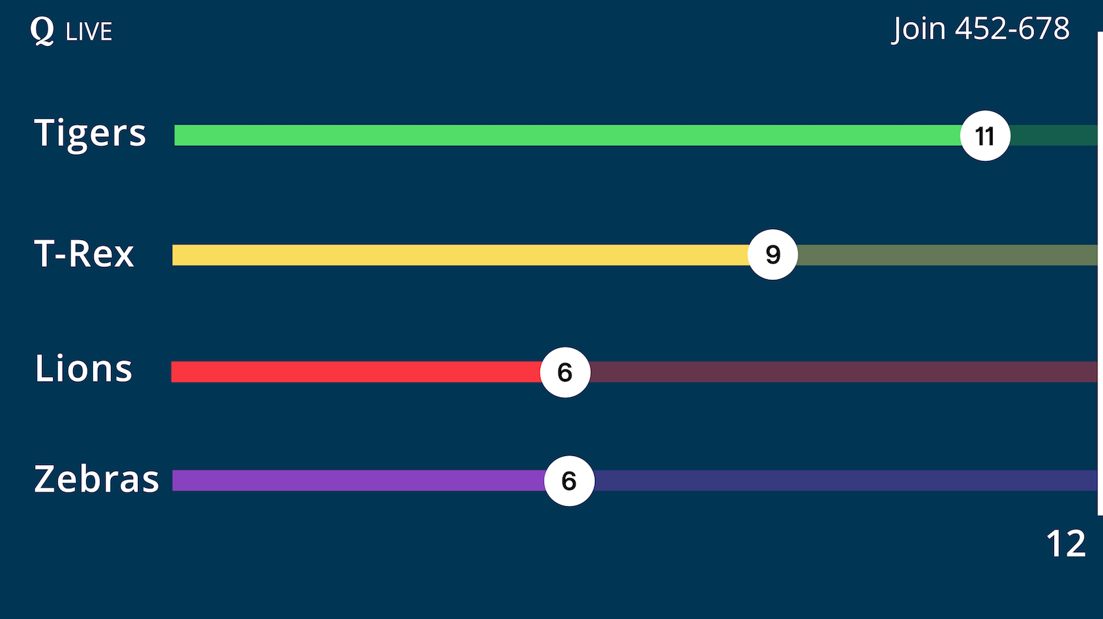
Quizlet Live
How it works:
To get started students will go to quizlet.live or quizlet.com/live and then enter the games joining code that the teacher will project on the board.
Students will enter their name. (Gives an option where the teacher can delete a name that is not the students real name and make them plug it back in.
Creates random teams on its own to help students work with different students.
As game is over there is a review section to go over with each other as a whole class.

